Slide 1
Simplifications of
Context-Free Grammars

Slide 2
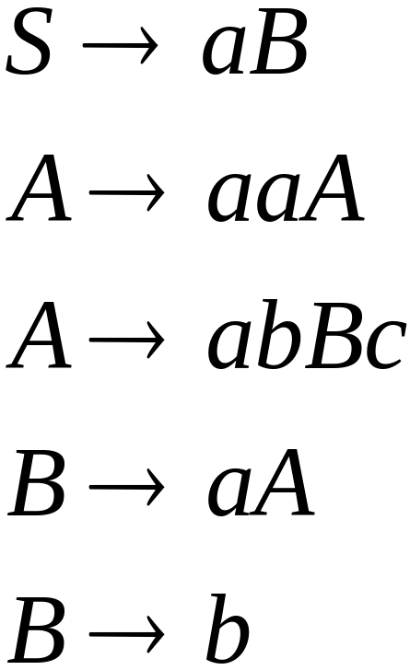
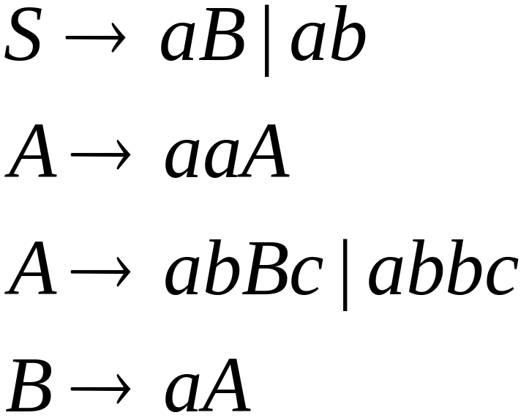

A Substitution Rule
Equivalent
grammar
Substitute

Slide 3


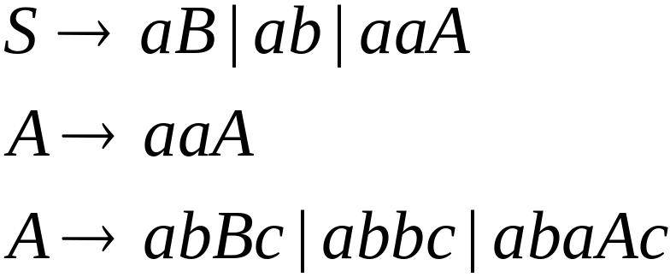
Substitute
Equivalent
grammar

Slide 4
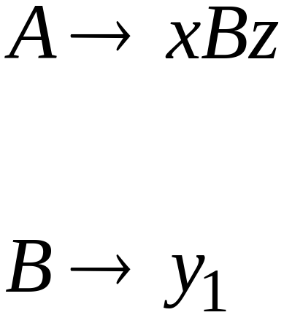
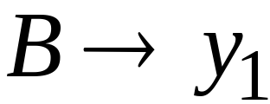
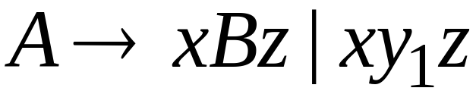
In general:
Substitute
equivalent
grammar

Slide 5
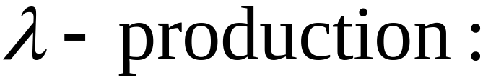


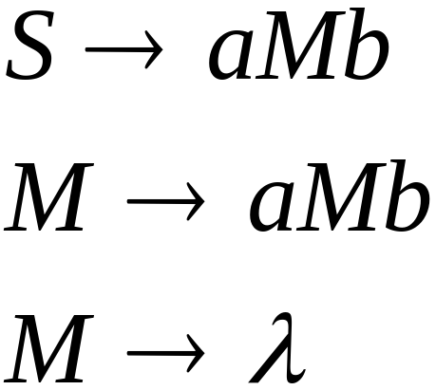
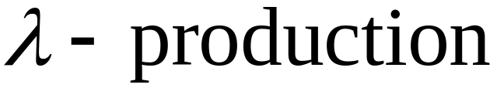
Nullable Variables
Nullable Variable:
Example:
Nullable variable

Slide 6
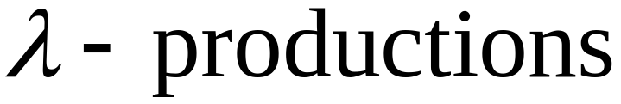
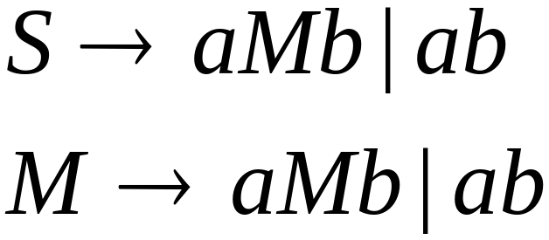

Removing
Substitute
After we remove all the
all the nullable variables disappear
(except for the start variable)

Slide 7

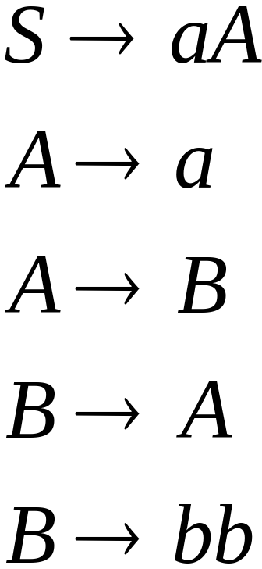
Unit-Productions
Unit Production:
(a single variable in both sides)
Example:
Unit Productions

Slide 8
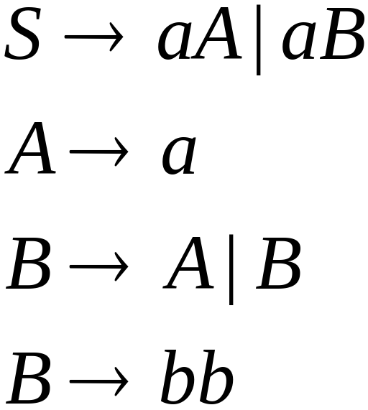

Removal of unit productions:
Substitute

Slide 9

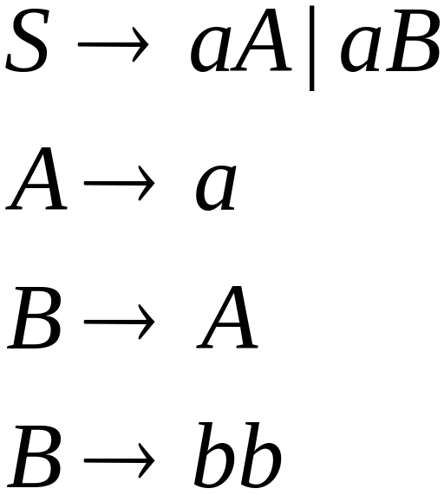

Unit productions of form
can be removed immediately
Remove

Slide 10
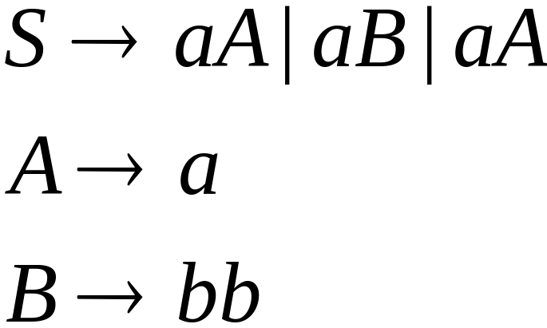

Substitute

Slide 11
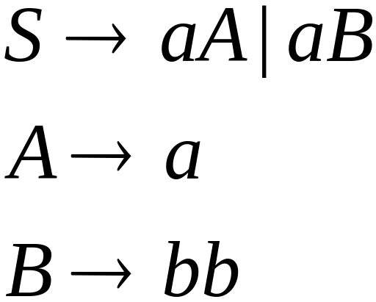
Remove repeated productions
Final grammar
Notes:
S->aA
A->a|bb

Slide 12
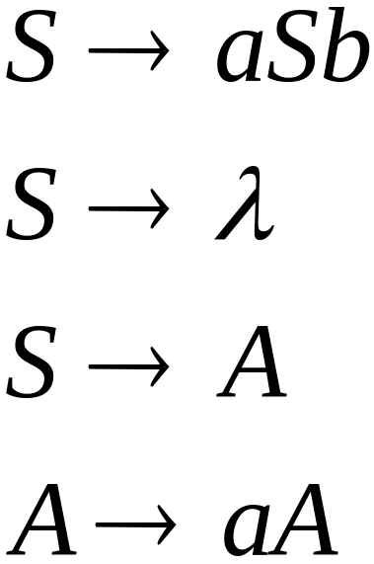
Useless Productions
Useless Production
Some derivations never terminate...

Slide 13
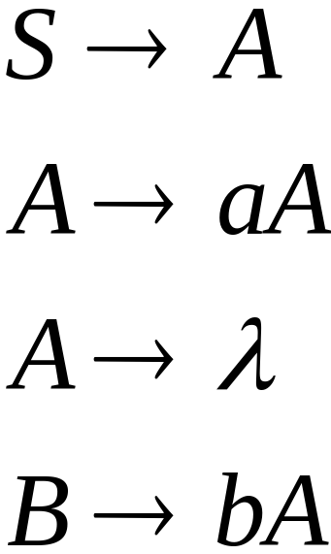
Another grammar:
Useless Production
Not reachable from S

Slide 14

In general:
If there is a derivation
consists of
terminals
Then variable is useful
Otherwise, variable is useless

Slide 15

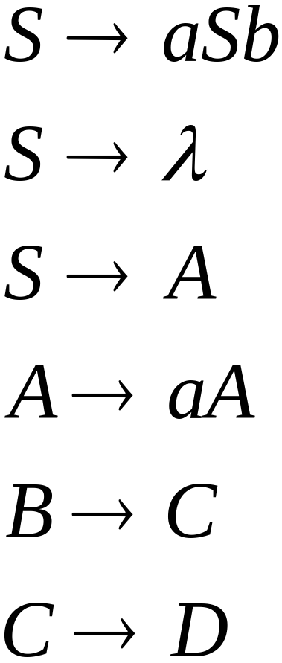
A production is useless
if any of its variables is useless
Productions
Variables
useless
useless
useless
useless
useless
useless
useless

Slide 16
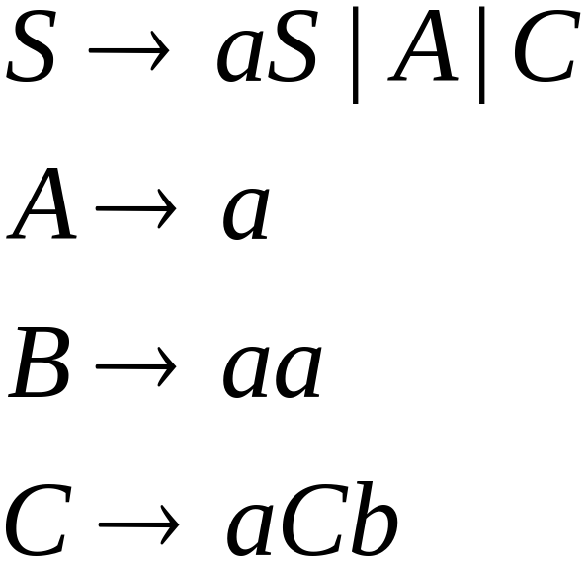
Removing Useless Variables and Productions
Example Grammar:

Slide 17


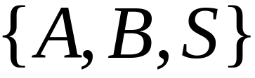
First:
find all variables that can produce
strings with only terminals or
(possible useful variables)
Round 1:
(the right hand side of production
that has only terminals)
Round 2:
(the right hand side of a production
has terminals and
variables of previous round)
This process can be generalized

Slide 18
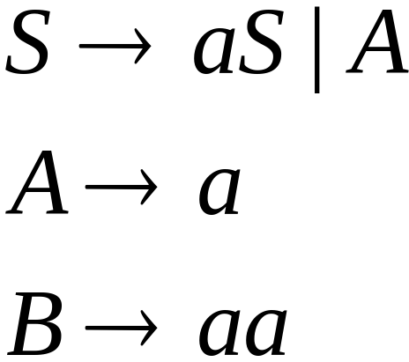
Then, remove productions that use variables
other than

Slide 19




Second:
Find all variables
reachable from
Use a Dependency Graph
where nodes are variables
unreachable

Slide 20
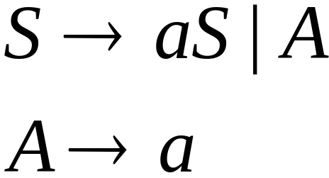
Keep only the variables
reachable from S
Final Grammar
Contains only
useful variables

Slide 21
Removing All
Step 1: Remove Nullable Variables
Step 2: Remove Unit-Productions
Step 3: Remove Useless Variables
This sequence guarantees that
unwanted variables and productions
are removed

Slide 22
Normal Forms for
Context-free Grammars

Slide 23


Chomsky Normal Form 定义 3.5 cp64
Each productions has form:
一分为二
终极化
or
variable
variable
terminal
A∈V and B,C∈V \{S}
a∈ Σ
For the start variable S we also allow the rule
S → ε

Slide 24
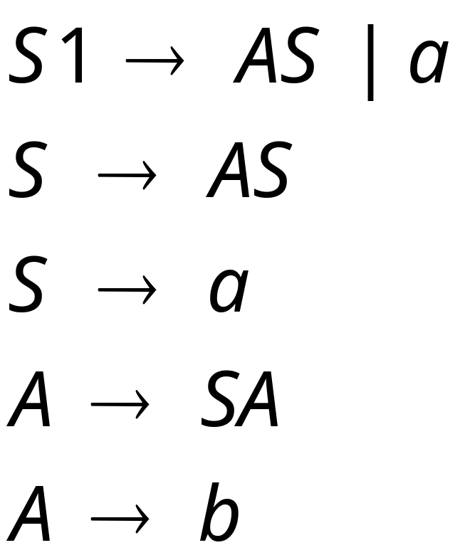
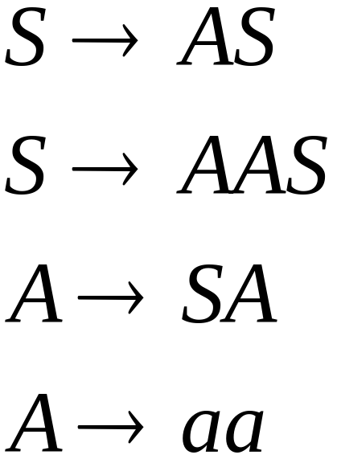
Examples:
Not Chomsky
Normal Form
Chomsky
Normal Form

Slide 25
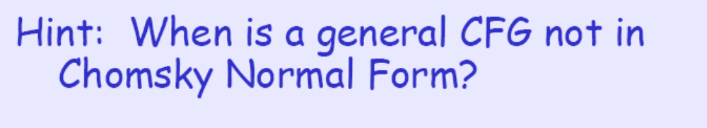
Theorem c3.6 ep99 cp67
Theorem: Every context-free language can be described by a grammar in Chomsky normal form. 任一上下文无关的语言都可以用乔姆斯基范式的上下文无关文法产生。

Slide 26
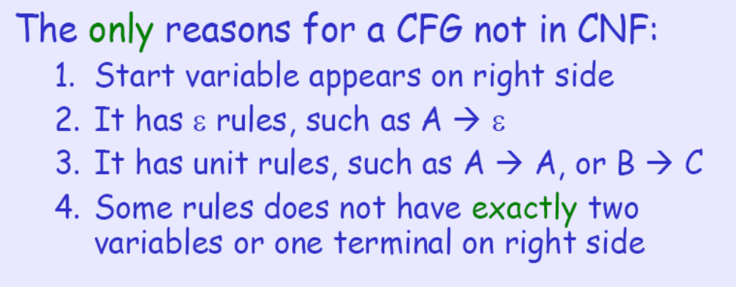
Proof Idea
Outline of Proof: or Key Points of proof
We rewrite every CFG in Chomsky normal form.
We do this by replacing, one-by-one, every rule
that is not ‘Chomsky’.
要点 一分为多 通过多个 一分为二 实现

Slide 27
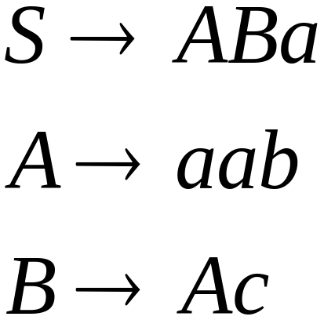
Conversion to Chomsky Normal Form
Example:
Not Chomsky
Normal Form
We will convert it to Chomsky Normal Form

Slide 28
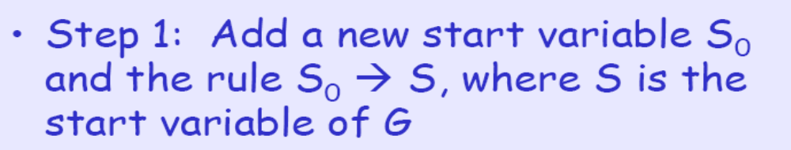
Conversion to Chomsky Normal Form
This ensures that start variable of the new grammar does not appear on right side

Slide 29
The Conversion (step 2)
Step 2: We take care of all λ rules. To remove the rule A→ λ, for each occurrence of A on the right side of a rule, we add a new rule with that occurrence deleted.(删除不包括起始变元的ε规则。 Remove A→ λ rules (from the tail))
before: B→xAy and A→ λ,
after: B→ xAy | xy
before: R→uAvAw and A→ λ,
after: R→ uAvw | uvAw | uvw | uAvAw
Removing A→ λ, the new grammar still generates the same language as G.

Slide 30
The Conversion (step 3)
Step 3: Remove unit rules A→B (by the head)
“A→B” and “B→xCy”, becomes
“A→xCy” and “B→xCy”
E.g. if we have “A→B” and “B→aC”, “B→CC” ,
We add A→aC, A→CC
Removing A→B, the new grammar still generates the same language as G.

Slide 31
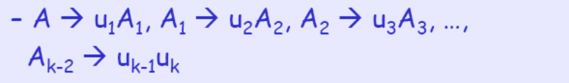
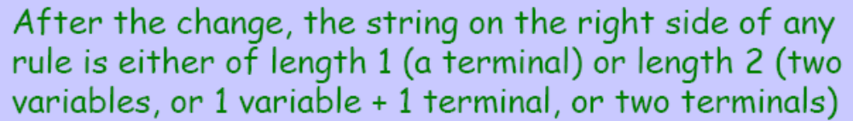
The Conversion (step 4)
Step 4: Suppose we have a rule A-> u1 u2 …uk, where k > 2 and each ui is a variable or a terminal. We replace this rule by
一分为多 通过多个 一分为二 实现

Slide 32

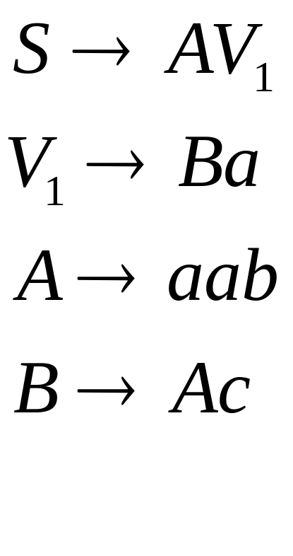
Introduce new intermediate variable
to break first production:

Slide 33
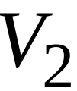
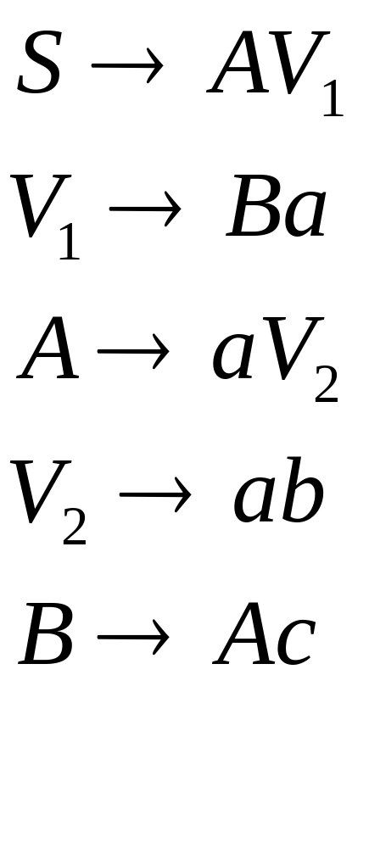
Introduce intermediate variable:

Slide 34
The Conversion (step 4’)
Step 4’: Replace ill-placed terminals “a” (on the right side with some variables )by Ta with Ta→a
Ta is a new variable, Ta→a is a added rule.
After the change, the string on the right side of any rule is exactly a terminal or two variables

Slide 35
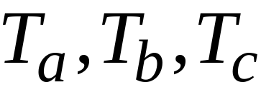
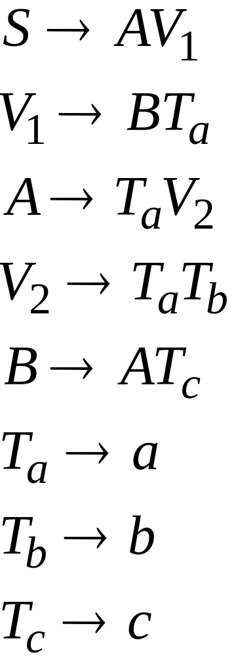
Introduce new variables for the terminals:

Slide 36

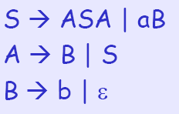
Example of Chomsky NF 补充例
Let G be the grammar on the left side. We get the new grammar on the right side after the first step.

Slide 37

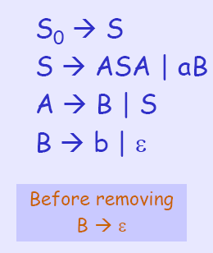
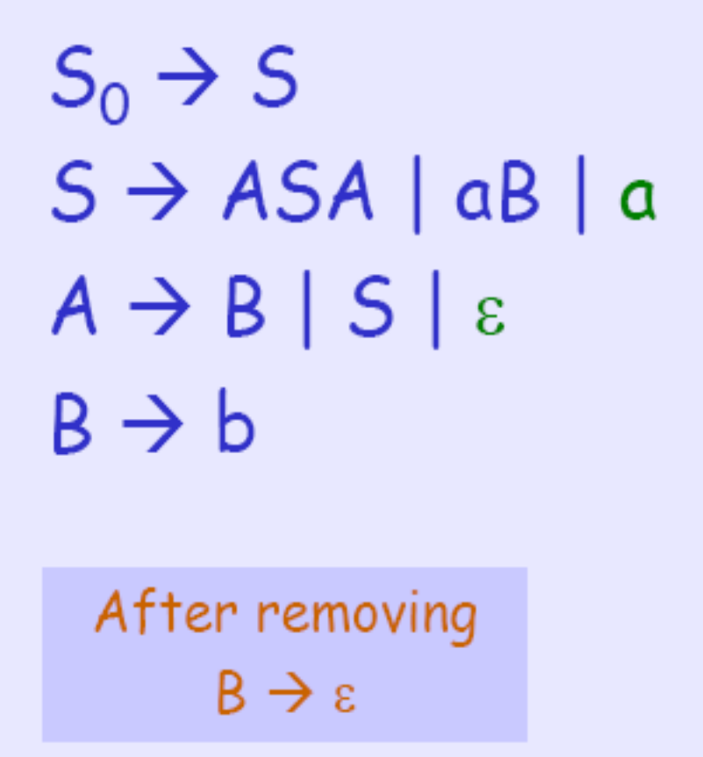
Example of Chomsky NF 补充例

Slide 38
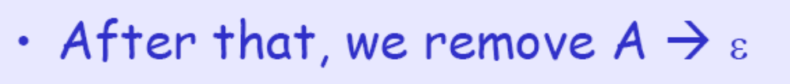
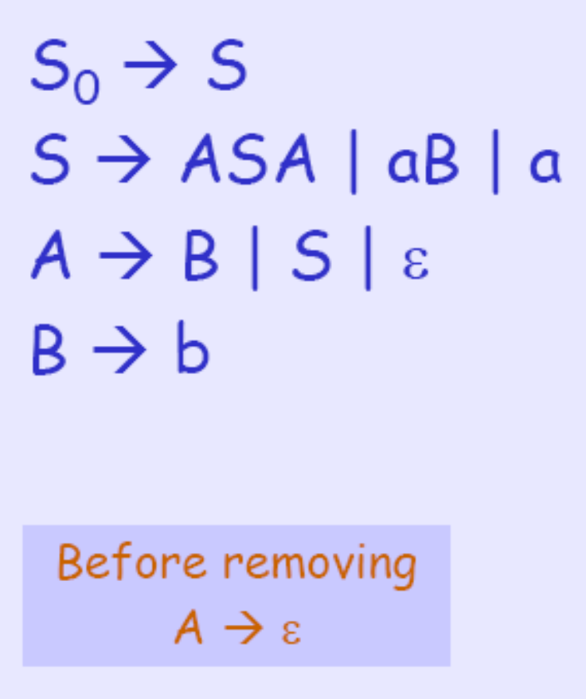
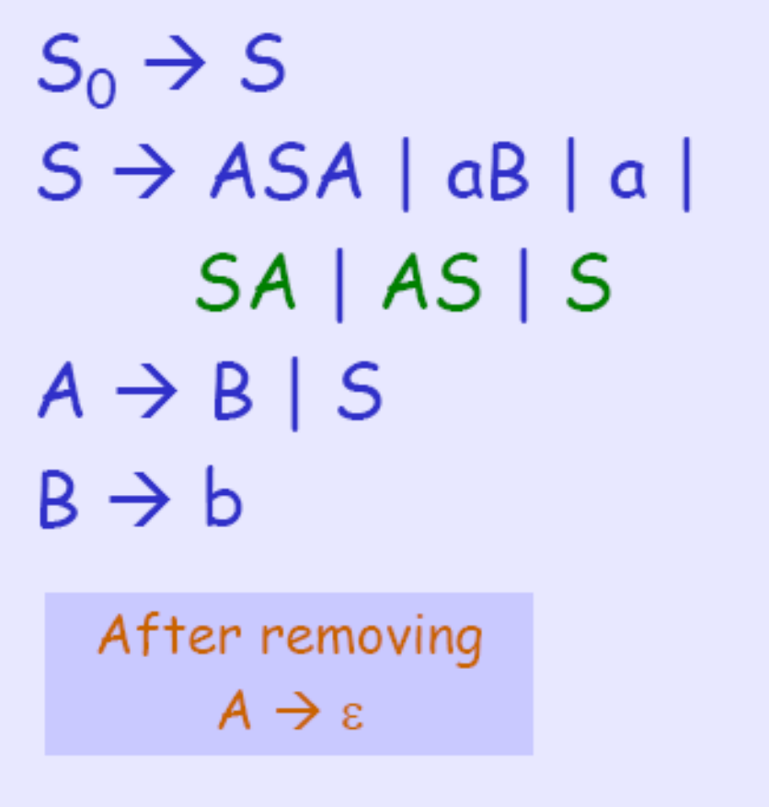
Example of Chomsky NF 补充例

Slide 39
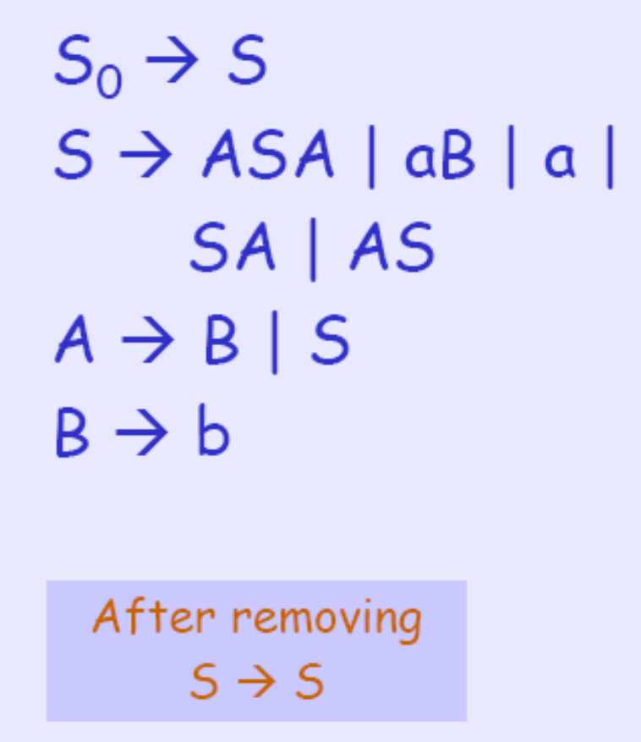
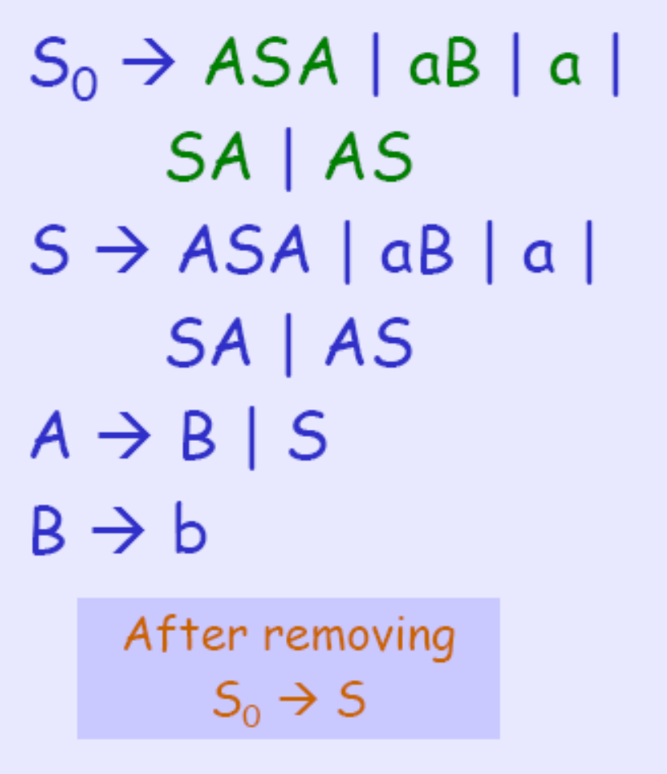
Example of Chomsky NF 补充例

Slide 40
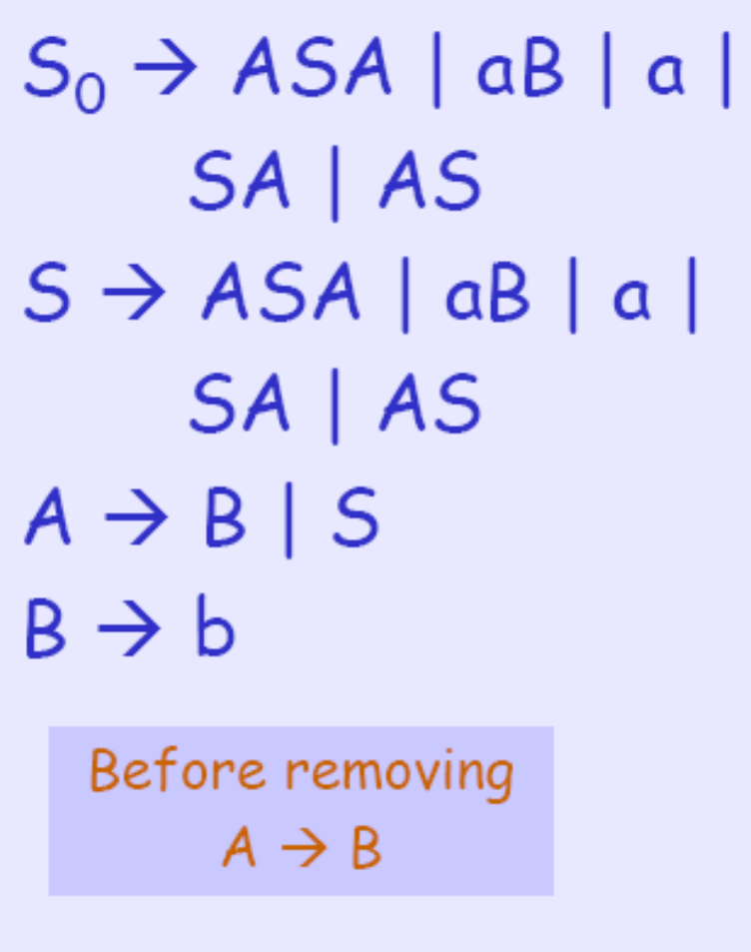
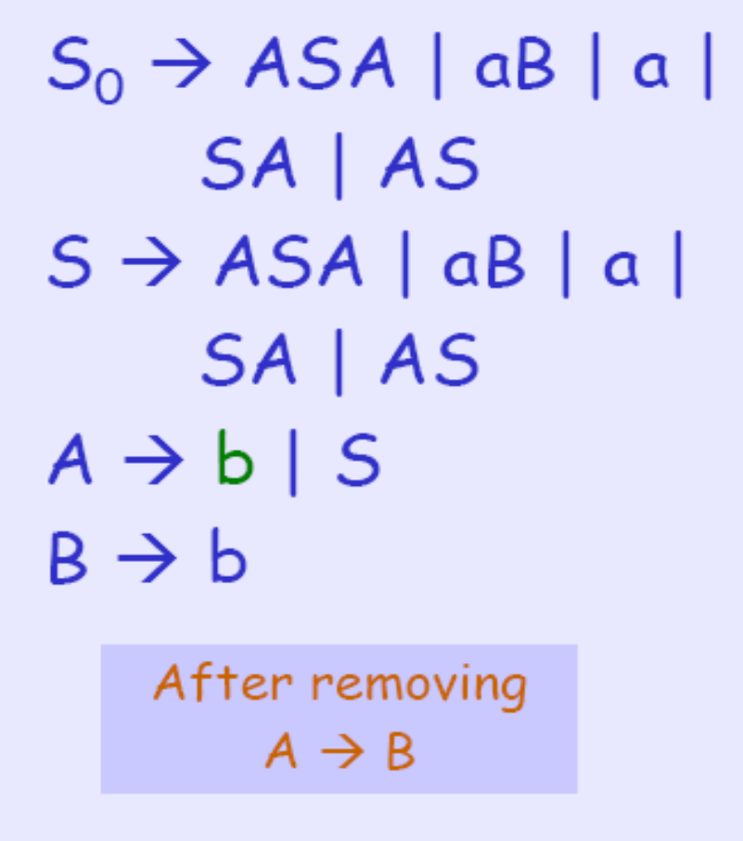
Example of Chomsky NF 补充例

Slide 41
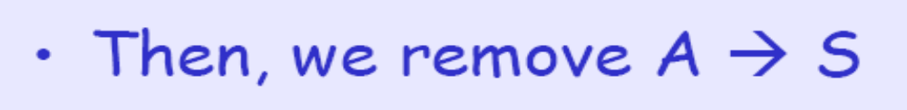
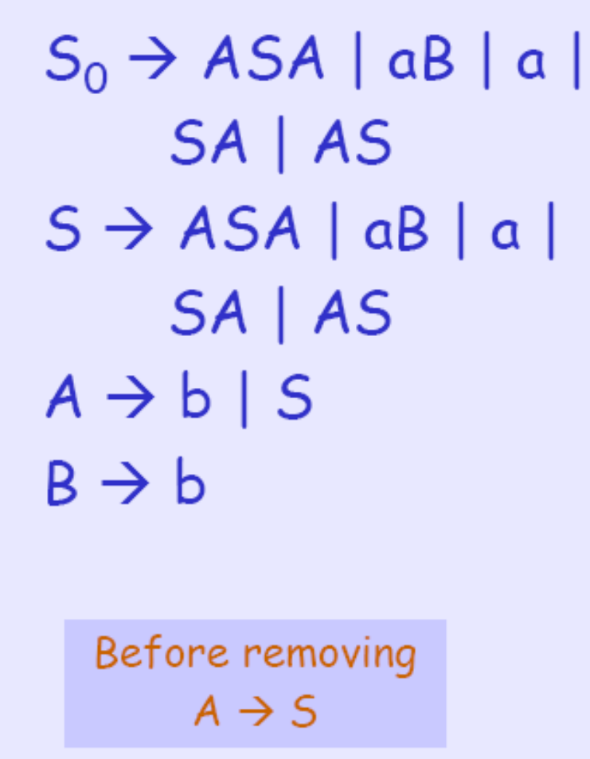
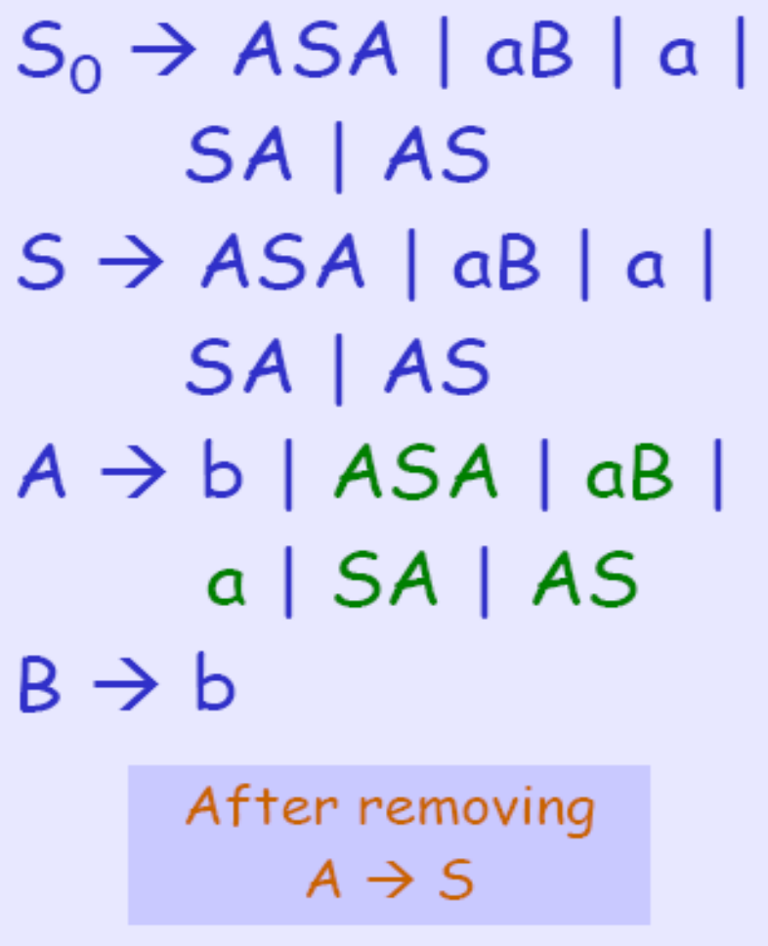
Example of Chomsky NF 补充例

Slide 42
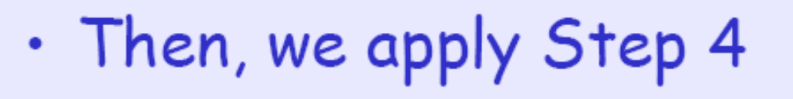


Example of Chomsky NF 补充例

Slide 43
Observations
Chomsky normal forms are good
for parsing and proving theorems
It is easy to find the Chomsky normal
form for any context-free grammar

Slide 44


Greinbach Normal Form
All productions have form:
symbol
variables
Notes:
格雷巴赫范式

Slide 45


Examples:
Greinbach
Normal Form
Not Greinbach
Normal Form

Slide 46

Conversion to Greinbach Normal Form:
Greinbach
Normal Form

Slide 47
Observations
Greinbach normal forms are very good
for parsing strings (better than Chomsky Normal Forms)
However, it is difficult to find the
Greinbach normal of a grammar

Slide 48
Example of Chomsky NF 补充例
Initial grammar: S→ aSb | ε
In Chomsky normal form:
S₀ → ε | T_{a}T_{b} | T_{a}X
X → ST_{b}
S → T_{a}T_{b} | T_{a}X
T_{a} → a
T_{b} → b

Slide 49
Importance of CFL
Model for programming languages (Noam Chomsky)
Specification of programming languages:
“parsing of a computer program” 词法分析和语法分析，是一种受限的比较规范的语言
Describes mathematical structures, et cetera
Intermediate between regular languages and
computable languages (Chapters 3,4,5 and 6)
介于RL 和 可计算集合

Slide 50
Context-Free Languages Def, ep99, cp6７
Any language that can be generated by a context
free grammar is a context-free language (CFL).
The CFL { 0^{n}1^{n} | n≥0 } shows us that certain
CFLs are nonregular languages. 某些CFL是RL
好奇心推动科技发展
Q1: Are all regular languages context free?
Yes.
Q2: Which languages are outside the class CFL?
CFL之外又有什么? 外面的世界更精彩。

Slide 51
Picture Thus Far
??
context-free
languages
Regular
languages
{ 0^{n}1^{n} }

Slide 52
小结
Why should we study CFGs?
• Precisely describe syntax of programming languages
What are the four parts of a CFG?
• Terminals, nonterminals, productions, start symbol
How do we tell if a string is accepted by a CFG?
• Find a derivation from start symbol to string
By applying productions to nonterminals at each step
What’s a parse tree?
• Representation of derivation of string

Slide 53

小结－REs and CFGs in Practice
REs turn raw text into a stream of tokens
• E.g., “if”, “then”, “identifier”, etc.
• This process is calling scanning or lexing
• Whitespace and comments are simply skipped
• These tokens become the input for the parser
CFGs turn tokens into parse trees
• This process is called parsing
• Parse trees become the input for the code generator

Slide 54




小结－Tips for Designing Grammars
1. Use recursive productions to generate an
arbitrary number of symbols
2. Use separate non-terminals to generate
disjoint parts of a language, and then combine
in a production

Slide 55

小结－Tips for Designing Grammars
3. To generate languages with matching, balanced, or related numbers of symbols, write productions which generate strings from the middle

Slide 56


小结－Tips for Designing Grammars
4. For a language that is the union of other
languages, use separate non-terminals for each
part of the union and then combine

Slide 57

Any Questions?

